Slide 1


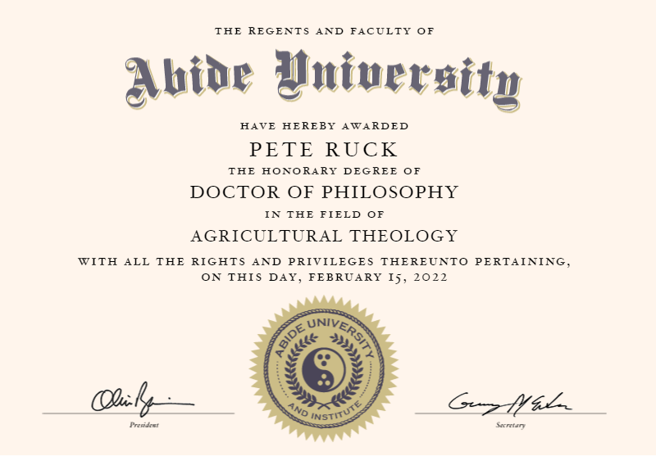
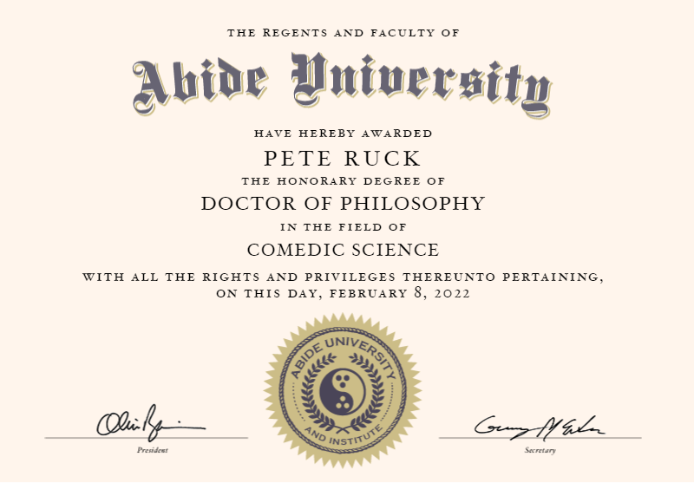
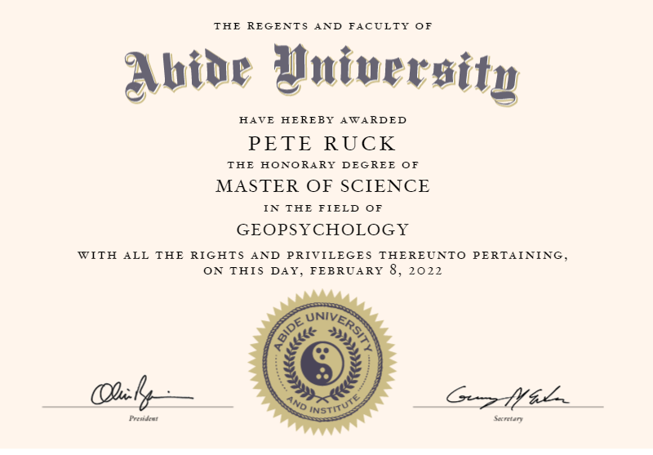
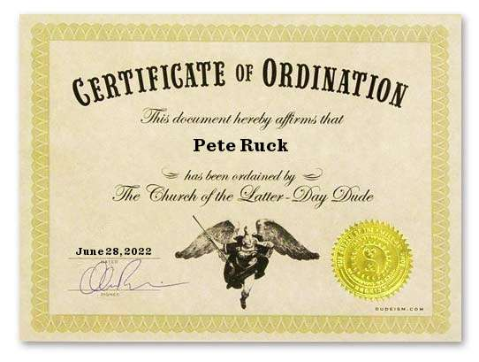
BAE NSAC Project
Dr Pete Ruck
PhD, MSc, Ordained.

Slide 2



Approach
Administration:
Jira, Github
Set Up:
Git, MySQL, VSC, Spring
Back end:
Testing
Front end:
Testing
Finalise project:
UML, .Jar, README.md

Slide 3




Sprint Plan Tab to Jira
Planning the subject and overall objectives of the project and was done through Jira and the Kanban board.

Slide 4











Journey

Slide 5

The way to get started is to quit talking and begin doing.
“Walt Disney”.

Slide 6

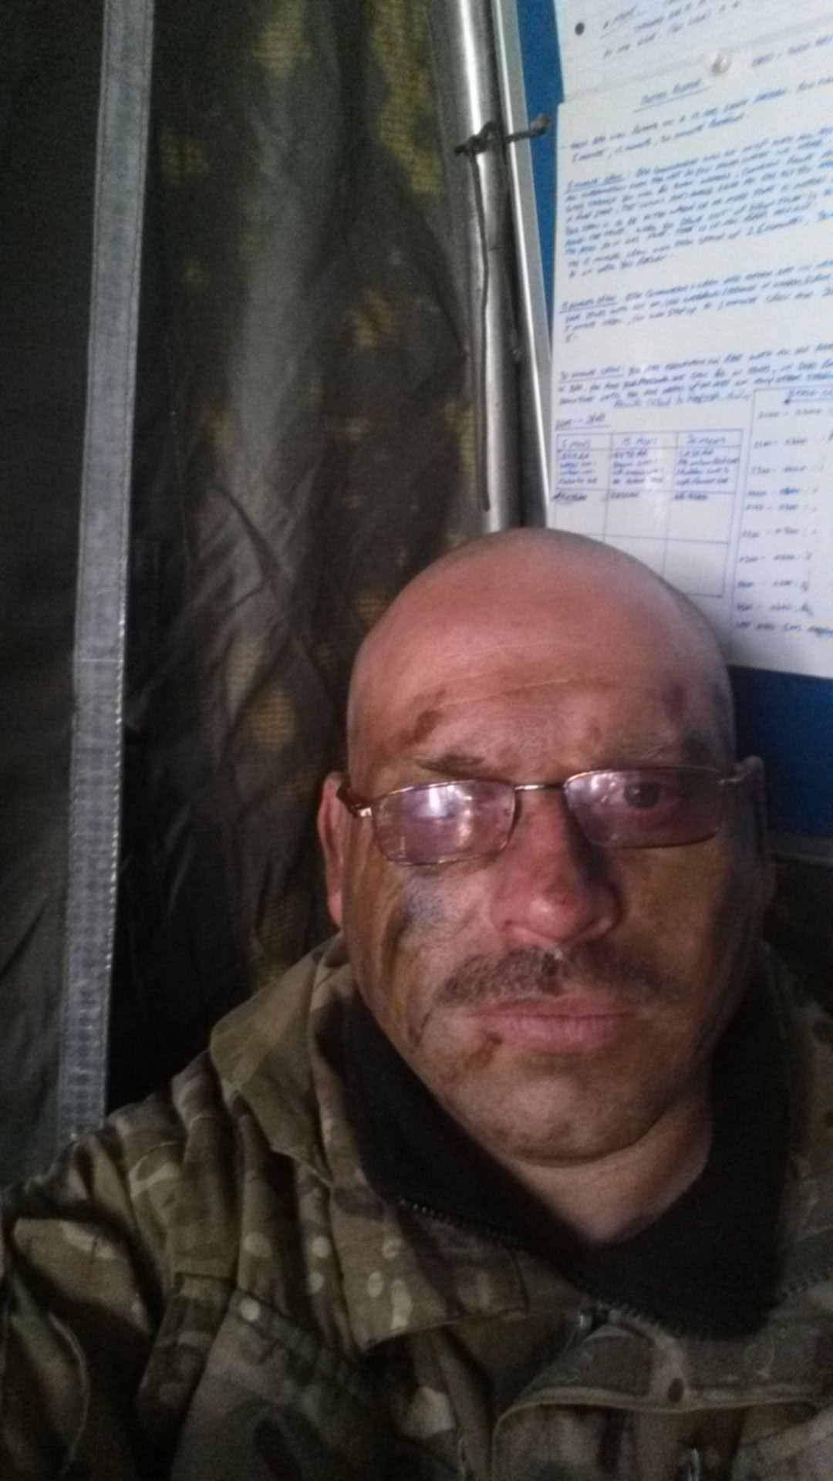
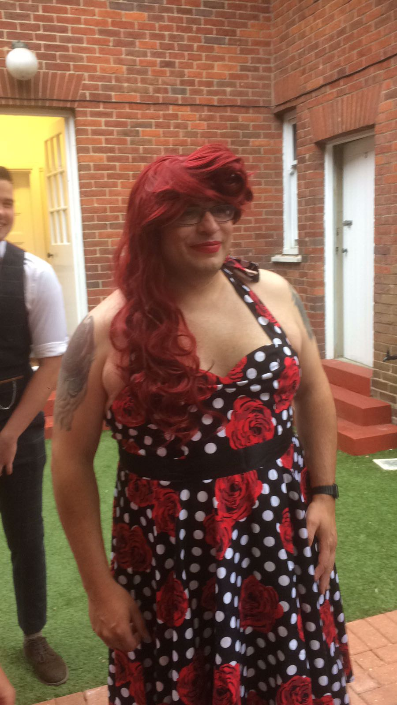

Meet the Team
Pete
Pete
Pete
Anoush
Front End, Moral.
Back end, MH
Admin and HR
Technical Support
Version control – Github.
Building the repository on Github means the whole team can work on parts of the project at the same time, without any problems.
Fork – dev branch - feature branch – commit – push – merge.

Slide 7
Testing.
Postman
Once the initial queries have been coded, testing with Postman is advisory.
Build Test Entity
The start of any testing phase, much like the start of the coding, is the Entity.
Integration Tests
With your Entity done, integration test builds are the next priority
Unit Tests
Examples
Time for some Screenshots
Once complete, Unit testing can start. These alone should give you the industry standard of 80% coverage.

Slide 8
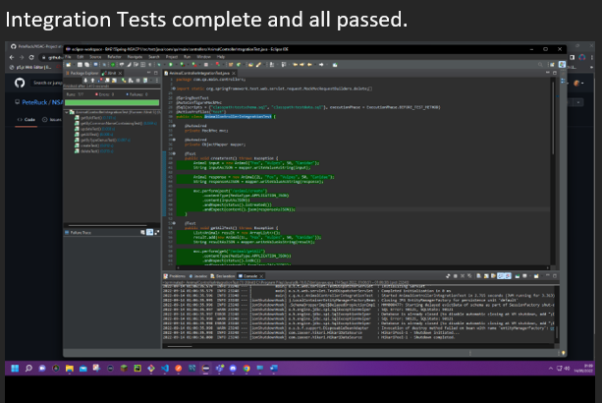
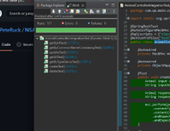

Slide 9
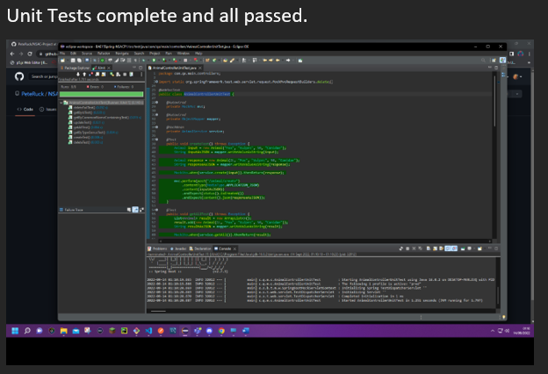
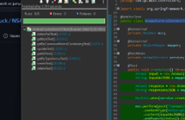

Slide 10
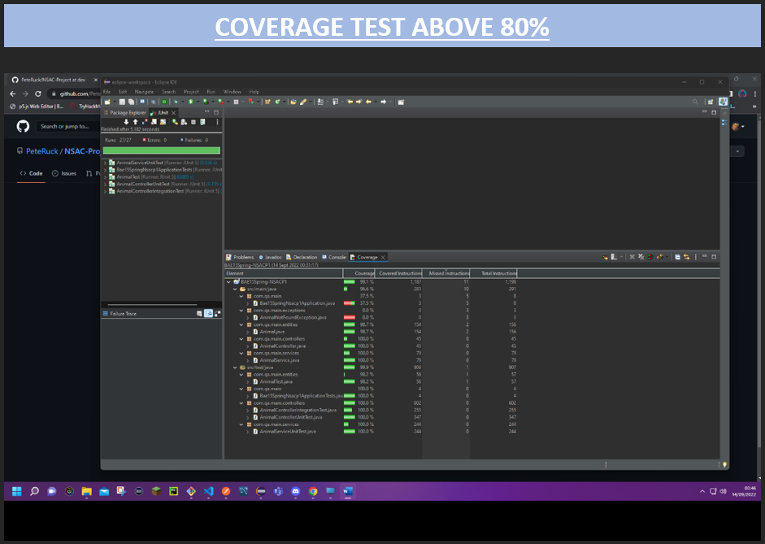
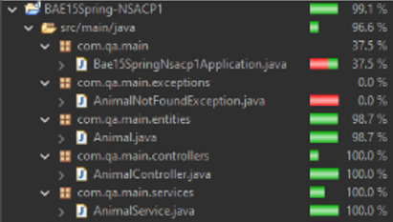

Slide 11
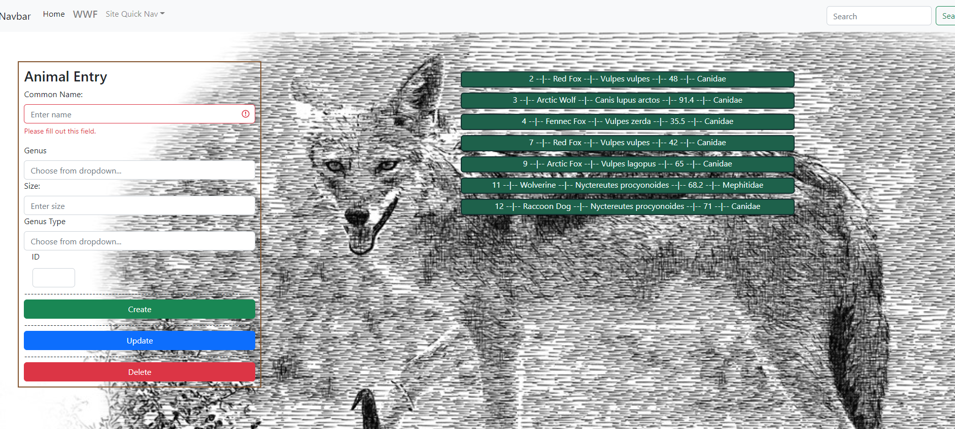
DEMO!!!!

Slide 12
SPRINT Overview
Complete
Left Behind
Improvements
All administration taskings.
All coding taskings.
All Testing – unit, integ, postman.
All Coverage – 99.1% (96.6%).
Front end functionality and integration with API.
Search by Genus Type.
Search by name containing.
Both areas were coded on the back end but when it came to it, I couldn’t connect the queries to the search bar or get my Modal working for the results to show in, so I sacked them to spend more time sanity checking the build and final admin tasks.
Check my coding and slow down!
Stop overthinking everything!
Stop trying to fly when you’re struggling to walk!!
Pretty much every problem I found could have been avoided if I’d have taken more time and not rushed full steam ahead, then overthinking the solutions took extra time.

Slide 13

Summary
I think my time utilization was good, I stuck to my timelines rigorously, and gave enough wiggle room for any dramas that inevitably cropped up!
The few problems I came across I managed to sort out, some with some guidance, but mostly through GOOGLE!!
In Future, baby steps, and don’t overthink it.

Slide 14


Thank You, and now Question Time!
Pete Ruck
peteruck@baesystems.com
https://tryhackme.com/p/Rucky

